Slide 1
Logistic Regression

Slide 2
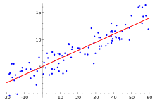
Linear Regression
Dependent Variable (y)
Numerical Value
Independent Variables (x)
Numerical Value
Yes/No (1/0) Binary Variable
We use this model to see how the independent variables influence the value of our dependent variable
Once we get a model estimated, we can plug in values for the X variables to get an estimated Y value out of the model. This is called a prediction
Model is very good for giving us numerical estimates

Slide 3
Logistic Regression
Dependent Variable (y)
Yes/No (1/0) Binary Variable
Independent Variables (x)
Numerical Value
Yes/No (1/0) Binary Variable
This model uses a 1/0 as the dependent variable
This means it is in the group or out of the group
When looking at the results, the coefficients on the independent variables show up if they add (or subtract) to being in the “in group”
When we estimate our model and plug in values for the x variables, we get a probability

Slide 4

Logistic Regression
For Linear Regression, our model took the form of:
For Logistic Regression, our model takes the form of:

Slide 5
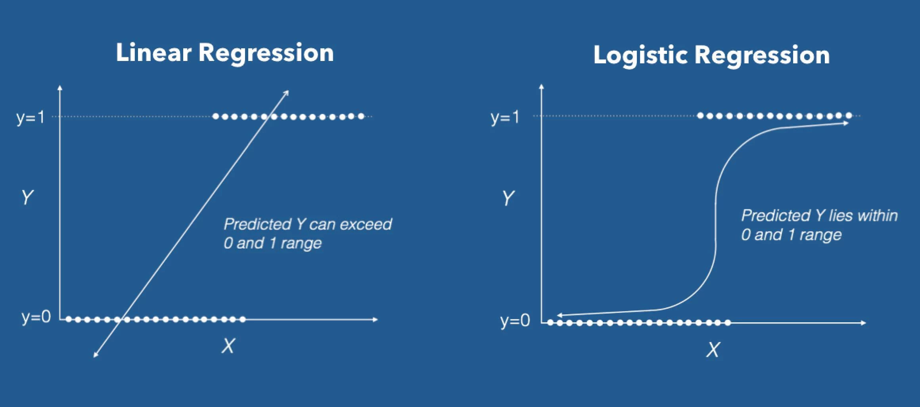

Slide 6
When Would We Want to Use This Model?
Customer Churn
Loan Default
Email Spam
Malignant Tumor
When ever we have a binary question, this is a good model to consider!

Slide 7
Assumptions of Logistic Regression
Binary Dependent Variable
No Outliers
No Multicollinearity
Independent observations
Fairly Large Sample size

Slide 8
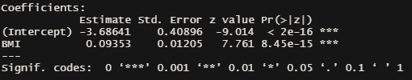
A Simple Example
We are a medical institution and we want to see the impact of BMI on the likelihood of diabetes
We will use BMI as our x variable. It is numeric
We will use Diabetes (1 = yes, 0 = no) as our dependent variable
From a dataset of 768 observations, we estimate the following model:

Slide 9

A Simple Example
The Positive coefficient on BMI indicates that patients with a higher BMI had a higher probability of having diabetes
Let’s use our model to predict the probability someone with a BMI of 10 has diabetes

Slide 10

A Simple Example
Let’s use our model to predict the probability someone with a BMI of 50 has diabetes

Slide 11
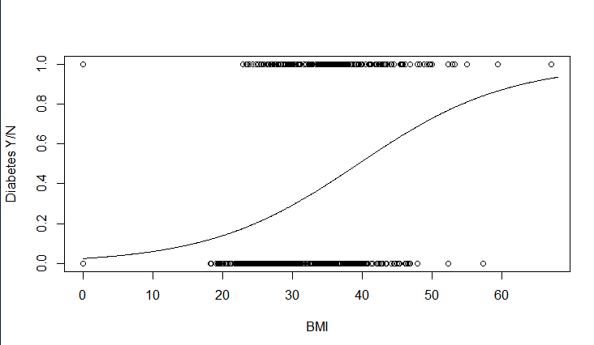
A Simple Example

Slide 12
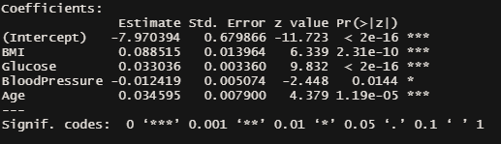
Multiple Variables

Slide 13
Model Fitting: VIF
Variance Inflation Factor (VIF) is an important post test to check for multicollinearity
Multicollinearity is when we have one or a combination of many independent variables explaining exactly what another variable explains
This causes issues when we calculate the regression model as our coefficients get out a whack
The general cutoff is variables with a VIF of greater than 5 need to be excluded from the model

Slide 14
Model Fitting: VIF

Slide 15
Model Fitting: Coefficient Significance
The coefficients on your regression estimate have a measure to calculate if they are important in looking at the effects of your dependent variable
We can use the p-value to determine which factors are significant and which are not
P-values run between 0 and 1
We generally use a cutoff of 0.1 and lower for a coefficient to be considered significant and to keep in the model

Slide 16
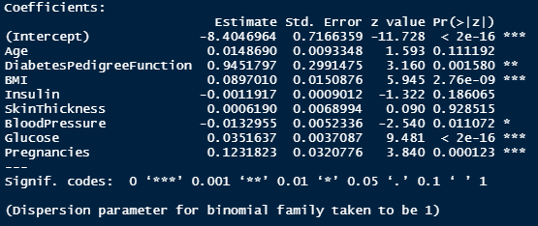
Model Fitting: Coefficient Significance
These are your p-values for each coefficient. The stars represent p-values that are less than 0.1. This means the coefficient (and variable) is important in our model

Slide 17
Model Fitting: Other Considerations
It is generally best to have an efficient and succinct model but there are other factors to consider:
Are there factors that do or do not make sense in the model despite the significance?
Are there issues of legality around using certain factors?
Are there institutional factors that need to be included despite the significance?

Slide 18
Model Fitting: R^2
Just like in linear regression, there is a Pseudo R^2 for logistic regression
It is a value between 0 and 1 where closer to 1 means a better fitting model
It is kind of hidden and we need to download a package for R to find it
See Logistic Regression handout on Canvas for the R code

Slide 19
Model Fitting: Summary
We always need to check the VIFs in order to drop variables that are causing multicollinearity. We should first drop the variable with the largest VIF and then re-run the model to check again. Repeat until all VIFs are under 5.
Then we should look at the significance of each coefficient. If the p-value is very large, you should consider dropping it.
In an age of big data and high computing power it is less important to drop variables with high p-values if you think that the factor should be included. Note that coefficients high p-values will not change your prediction estimate by much. Consider the trade-offs when building your model.

